Slide 1
Operating Systems: Processes & CPU Scheduling
IN2140: Introduction to Operating Systems and Data Communication
Pål Halvorsen

Slide 2
Overview
Processes
primitives for creation and termination
states
context switches
(processes vs. threads)
CPU scheduling
classification
timeslices
algorithms

Slide 3

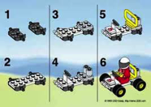

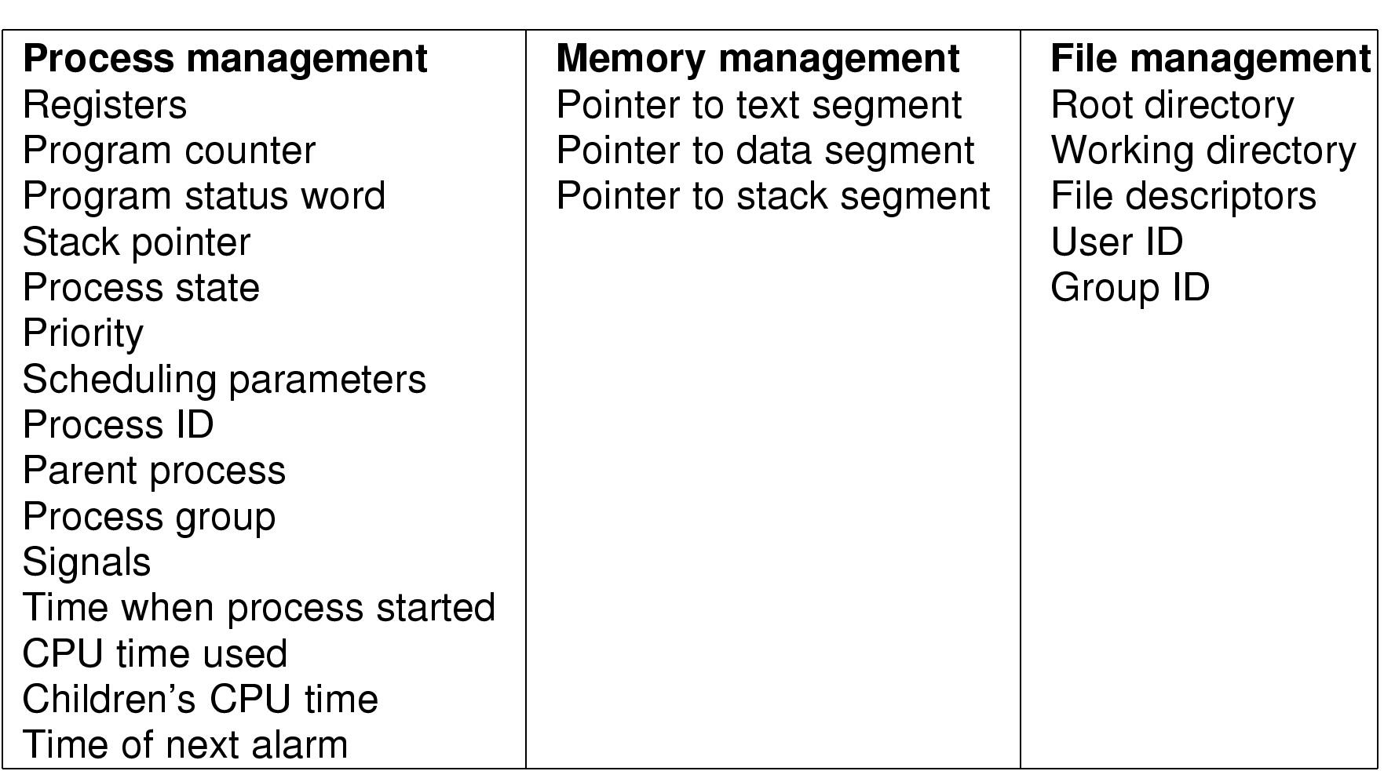
Processes
What is a process?
The "execution" of a program is often called a process
Process table entry (process control block, PCB):
Process
Program
vs.
Notes:
Process vs. program
- program often part of process
- program can specify the process to fork several processes

Slide 4



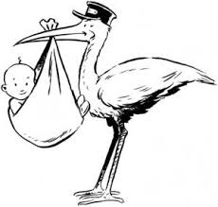

Process States
running
process termination
process blocks for input
scheduler stops process
scheduler starts process
blocked
ready
external event finished
process creation

Slide 5
Context Switches
Context switch: the process of switching one running process to another
stop running process 1
store the state (like registers, instruction pointer) of process 1 (usually on stack or PCB)
restore state of process 2
resume operation on program counter for process 2
essential feature of multi-tasking systems
computationally intensive, important to optimize the use of context switches
some hardware support, but usually only for general purpose registers
Possible causes:
scheduler switches processes (and contexts) due to algorithm and time slices
interrupts
required transition between user-mode and kernel-mode

Slide 6
CPU Scheduling

Slide 7
Scheduling
A task is a schedulable entity/something that can run (a process/thread executing a job, e.g., a packet through the communication system or a disk request through the file system)
In a multi-tasking system, several tasks may wish to use a resource simultaneously
A scheduler decides which task that may use the resource, i.e., determines order by which requests are serviced, using a scheduling algorithm
requests
scheduler
resource
Finally, the dispatcher “moves” the selected process to the CPU
Notes:
The difference between scheduler and dispatcher is that the scheduler selects a process out of several processes to be executed while the dispatcher allocates the CPU for the selected process by the scheduler.

Slide 8
Scheduling units
4 words: Process, Thread, Task, Job - very confusing
Task
Generic term used for ...
... sthg. that requires CPU time
... sthg. that has a process control block
... sthg. that can be scheduled by the CPU scheduler
Process
Thread
Job
Two types:
Kernel thread: the normal scheduling unit in a consumer OS
User-level thread (green threads): implemented in user space in a run-time environment (Java JVM until 2000)
Two uses:
a task in a batch system that has IO ony at start and end and is not preemptable
a task that is allowed to work like a batch job
Three uses:
saying process but meaning task
a simple way of saying «a process with a single thread»
a task in an OS that has no kernel threads

Slide 9
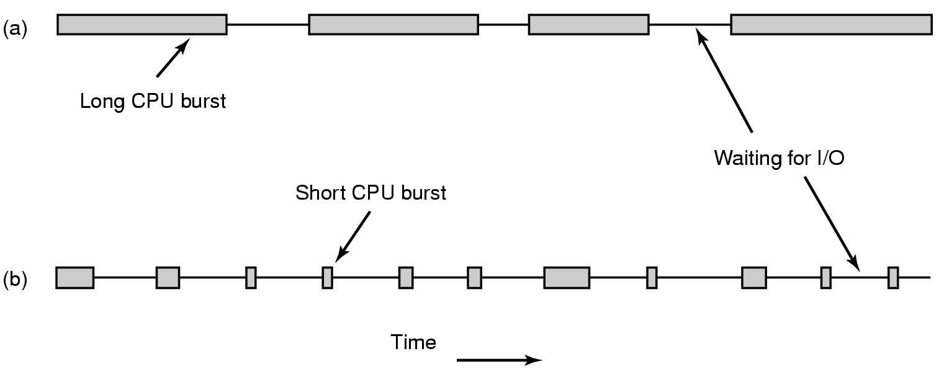
Why Spend Time on Scheduling?
Optimize the system to the given goals
e.g., CPU utilization, throughput, response time, fairness, …
Example: CPU-bound vs. I/O-bound Processes:
Bursts of CPU usage alternate with periods of I/O wait

Slide 10
Many Algorithms Exist
First In First Out (FIFO)
Round-Robin (RR)
Shortest Job First
Shortest Time to Completion First
Shortest Remaining Time to Completion First (a.k.a. Shortest Remaining Time First)
Lottery
Fair Queuing
…

Slide 11
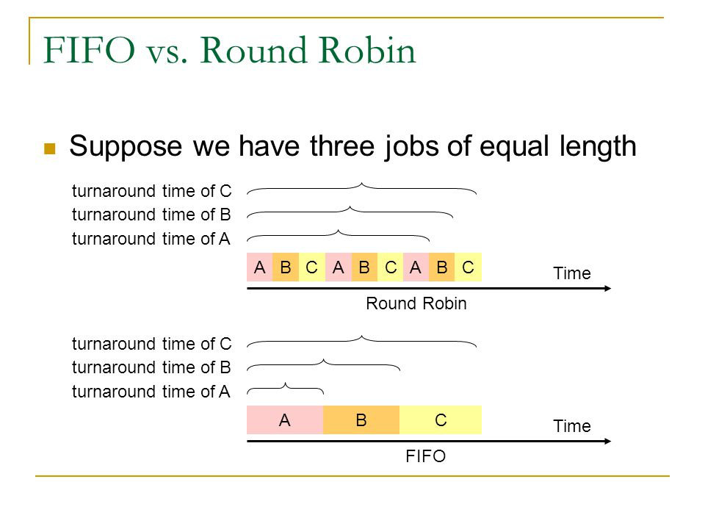
FIFO and Round Robin
FIFO:
Run
to completion (old days)
until blocked, yield or exit
Advantages
simple
Disadvantage
long waiting times
Round-Robin (RR):
FIFO queue
Each process runs a given time
each process gets 1/n of the CPU in max t time units per round
the preempted process is put back in the queue

Slide 12
FIFO and Round Robin
Example: 10 jobs and each takes 100 seconds, assuming no overhead (!?)
FIFO – the process runs until finished
start: job1: 0s, job2: 100s, ... , job10: 900s → average 450s
finished: job1: 100s, job2: 200s, ... , job10: 1000s → average 550s
some get long waiting time, but some are lucky
RR – time slice of 1s
start: job1: 0s, job2: 1s, ... , job10: 9s → average 4.5s
finished: job1: 991s, job2: 992s, ... , job10: 1000s → average 995.5s
fair, but no one is lucky
Comparisons
FIFO better for long CPU-intensive jobs (there is overhead in switching!!)
but RR much better for interactivity!
But, how to choose the right time slice??

Slide 13




Scheduling: goals
“Most reasonable” criteria depend on who you are
Kernel
Resource management
processor utilization, throughput, fairness
User
Interactivity
response time (Example: when playing a game, we will not accept waiting 10s each time we use the joystick)
Predictability
identical performance every time (Example: when using the editor, we will not accept waiting 5s one time and 5ms another time to get echo)
“Most reasonable” criteria depend on environment
Server vs. end-system
Stationary vs. mobile
…
vs.
vs.

Slide 14
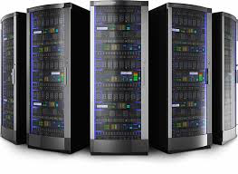

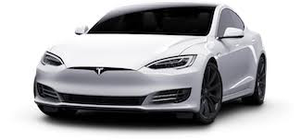
Scheduling: goals
“Most reasonable” criteria depend on target system
Most/All types of systems
fairness – giving each process a fair share
balance – keeping all parts of the system busy
Batch systems
turnaround time – minimize time between submission and termination
throughput – maximize number of jobs per hour
(CPU utilization – keep CPU busy all the time)
Interactive systems
response time – respond to requests quickly
proportionality – meet users’ expectations
Real-time systems
meet deadlines – avoid loosing data
predictability – avoid quality degradation in multimedia systems

Slide 15
Scheduling classification
Scheduling algorithm classification:
dynamic
makes scheduling decisions at run-time
flexible to adapt
considers only the actual task requests and execution time parameters
large run-time overhead finding a schedule
static
makes scheduling decisions off-line (also called pre-run-time)
generates a dispatching table for the run-time dispatcher at compile time
needs complete knowledge of the task before compiling
small run-time overhead
preemptive
running tasks may be interrupted (preempted) by higher priority processes
preempted process continues later at the same state
overhead of contexts switching
non-preemptive
running tasks will be allowed to finish its time-slot (higher priority processes must wait)
reasonable for short tasks like sending a packet (used by disk and network cards)
less frequent switches

Slide 16
Preemption
Tasks waits for processing
Scheduler assigns priorities
Task with highest priority will be scheduled first
Preempt current execution if
a higher priority (more urgent) task arrives
timeslice is consumed
…
Real-time and best effort priorities
real-time processes have higher priority (if such processes exist, they will run)
Two kinds of preemption:
preemption points
predictable overhead
simplified scheduler accounting
immediate preemption
needed for hard real-time systems
needs special timers and fast interrupt and context switch handling
requests
scheduler
preemption
resource

Slide 17


When to Invoke the Scheduler?
Process creation
Process termination
Process blocks
Interrupts occur
Clock interrupts in the case of preemptive systems

